Slide 1
Gimnazija Sisak
Highschool in Sisak, Croatia

Slide 2
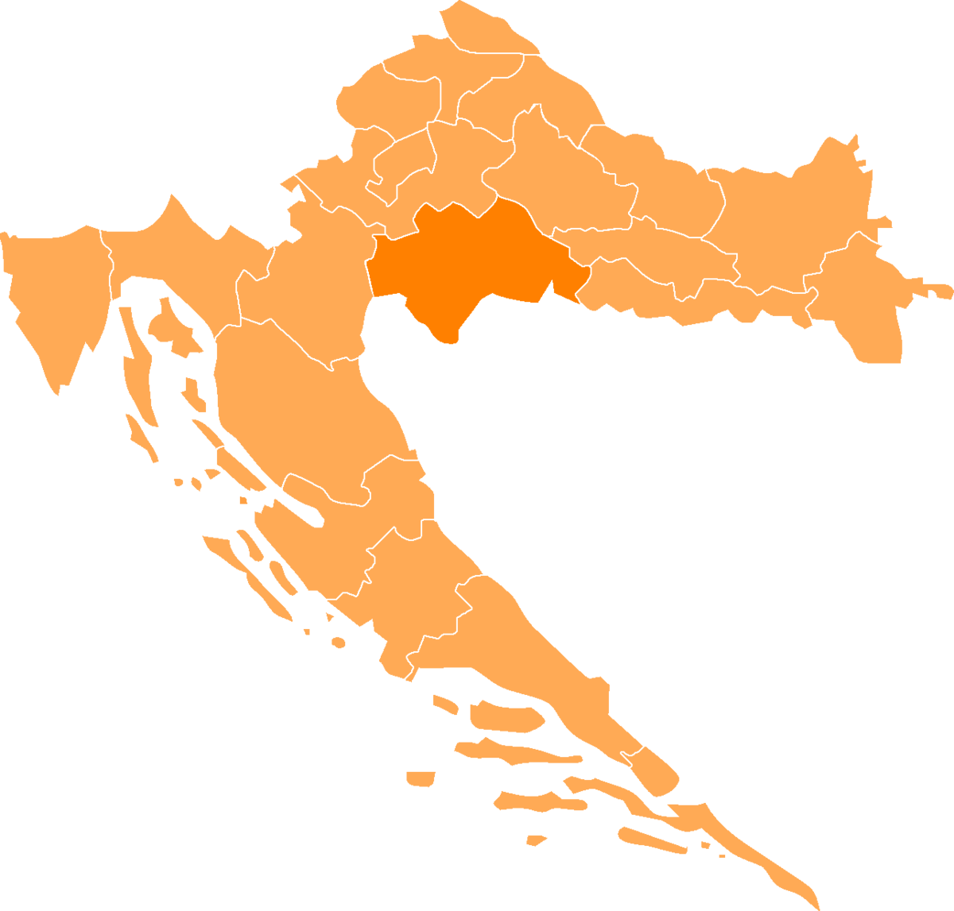
Sisak, where is that?
SISAK
city in central Croatia, 57km southeast of the Croatian capital city Zagreb
city on three rivers (Kupa, Sava, Odra)
population: 47,800 people (2011)

Slide 3
Something about our highschool
Our highschool was opened in 1919, and the first ever class to graduate in it was in 1925.
While it was still part of the School of Economics, it had 1,750 students and 105 employees, of which 85 were professors (1978).
Officially, the Gymnasium started to exist as an independent school on September 1st 1992, after being separated from the School of Economics.
After it separated it got devided into language, mathematics and general course.
Now our highschool has 42 professors and around 400 students.

Slide 4
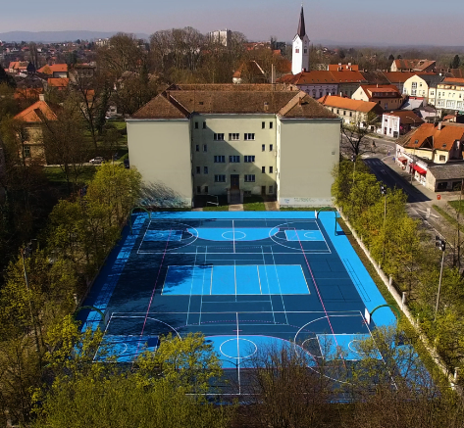
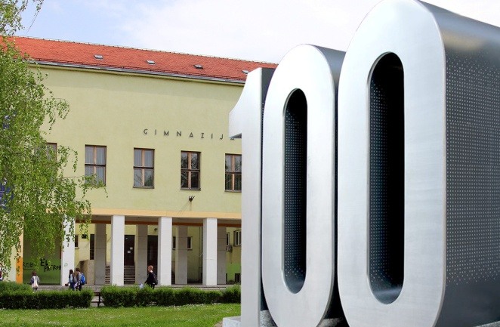
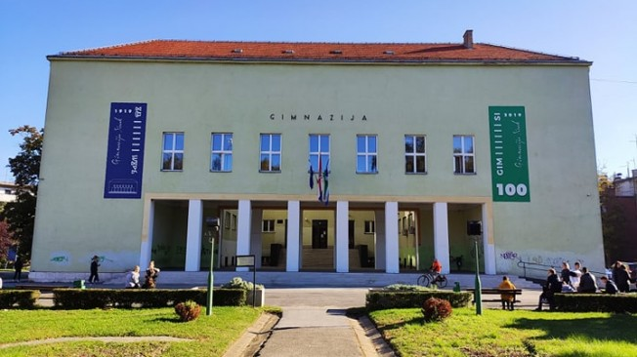
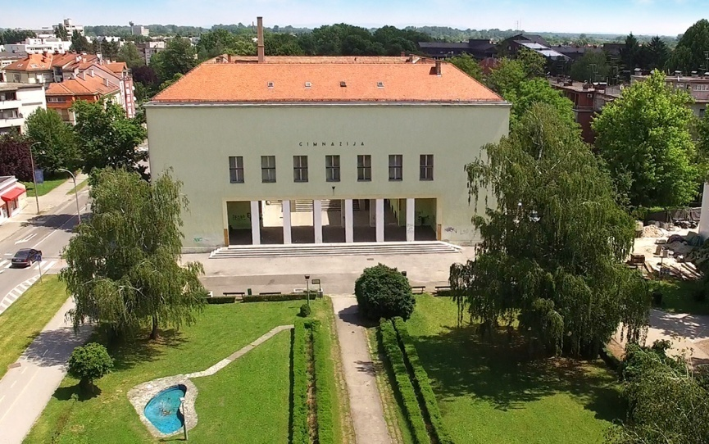
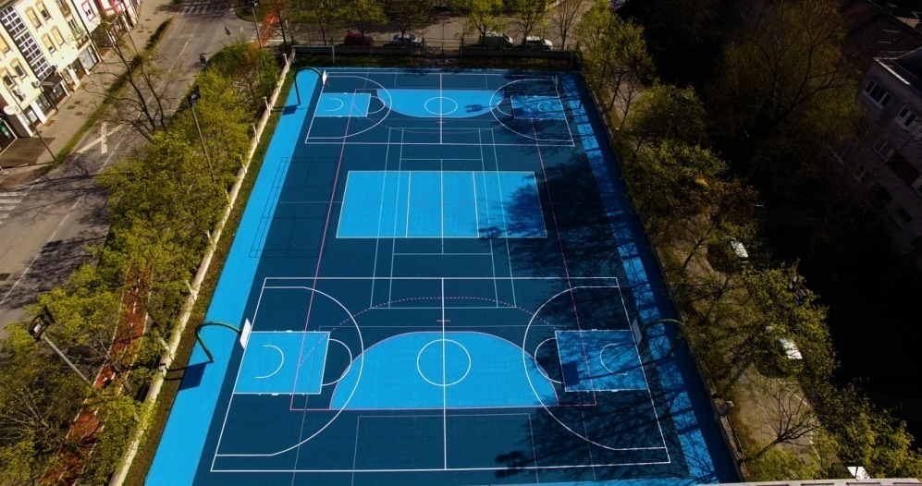
Pictures of our original school

Slide 5
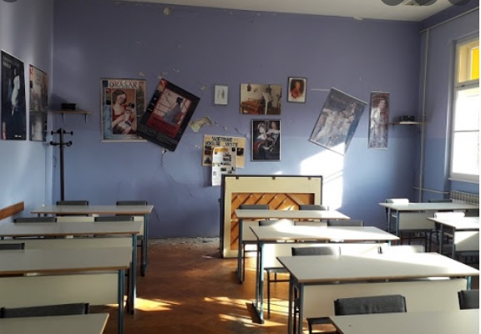
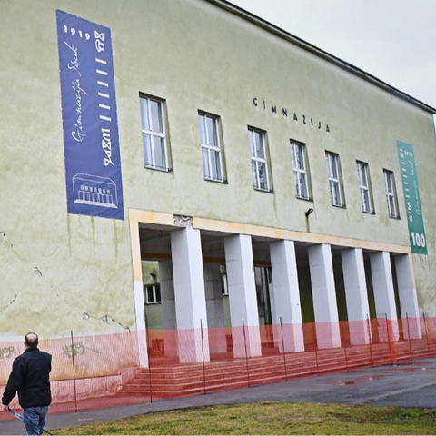
All good things must come to an end...
After a big earthquake in 2020 our school got badly damaged, but fortunately we moved to another building while our original school is getting renewed.

Slide 6
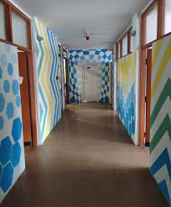
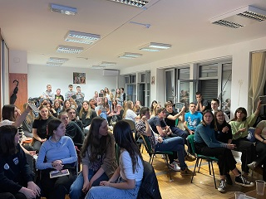
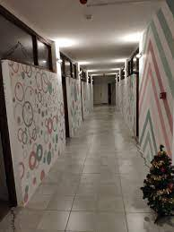
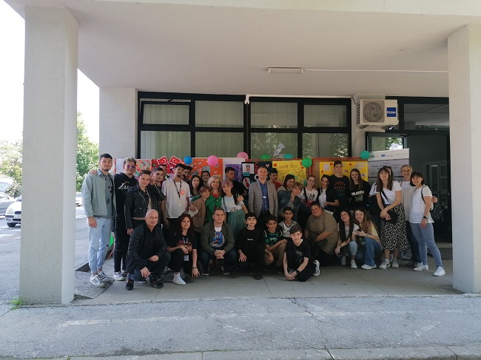
Our new school

